Slide 1
The Analysis of the NEIGHBOURHOODS of LONDON
Capstone Project

Slide 2
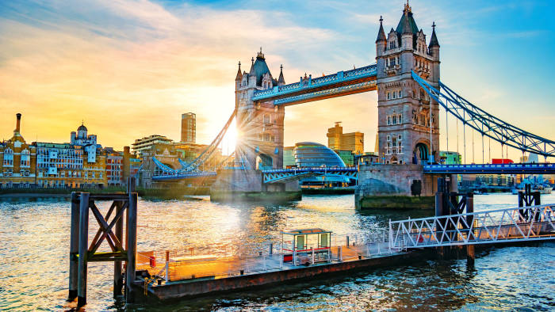
Introduction
London is much more than just a list of 32 boroughs, or the squiggly colored lines of the tube map.
In this project, I try to analyze, understand, and explore neighborhoods. To get the most common venue categories in each area, and then use this feature to group the neighborhoods into clusters.

Slide 3
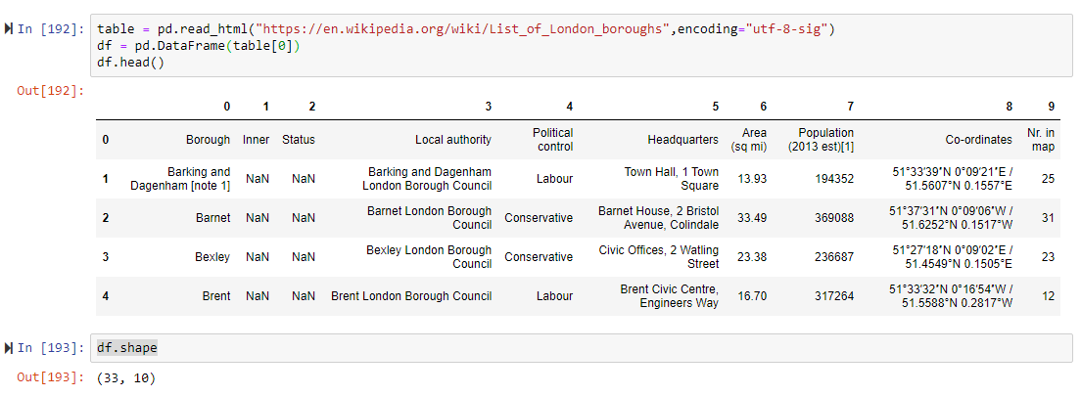
Data
public data from Wikipedia and Foursquare
https://en.wikipedia.org/wiki/List_of_London_boroughs

Slide 4
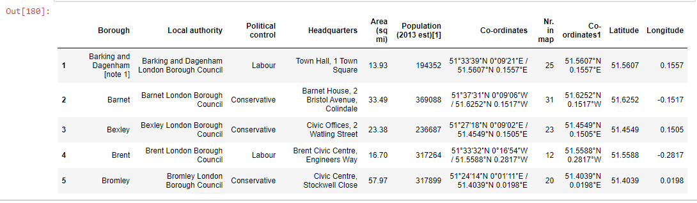
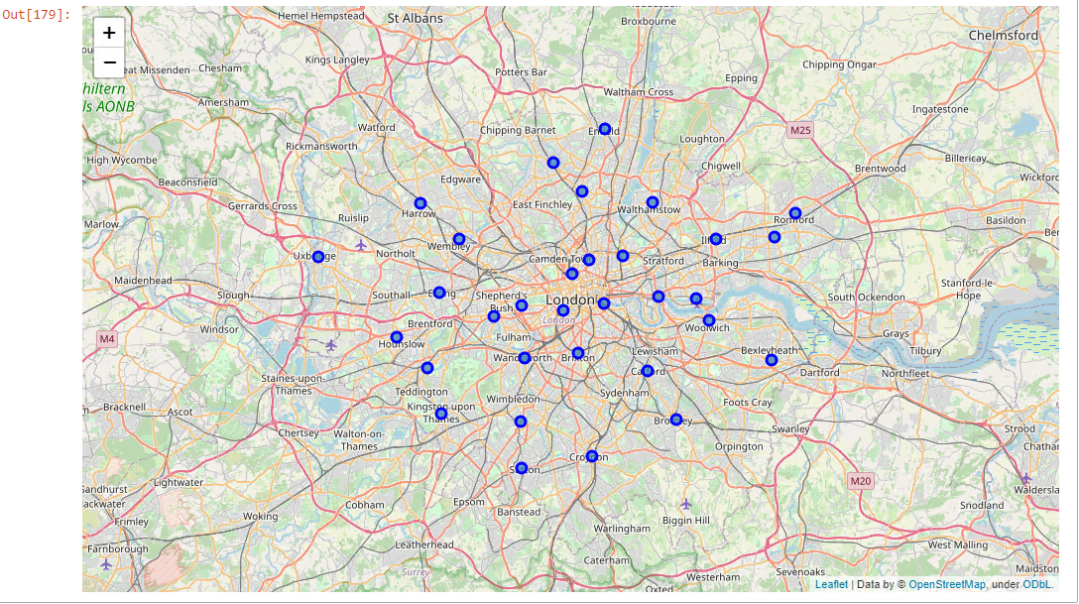
Cleaned dataset and visualization:

Slide 5
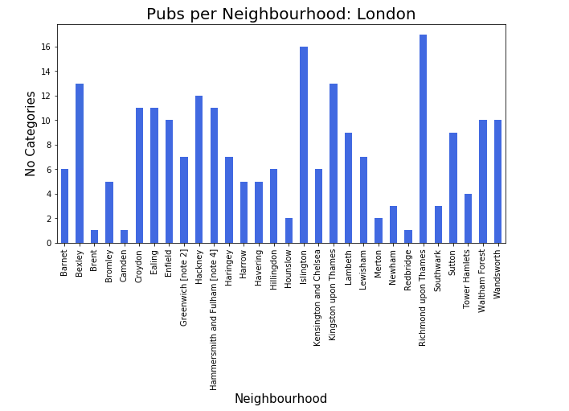
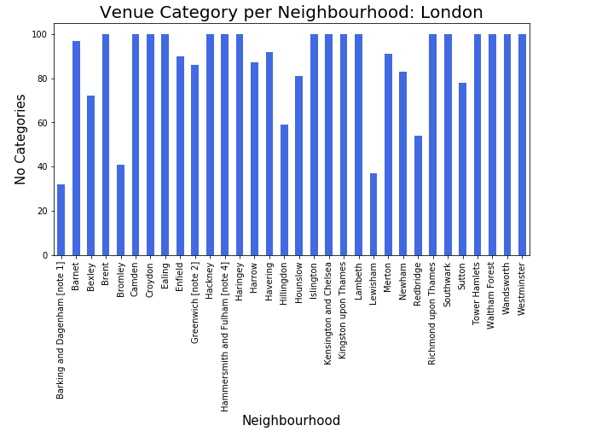
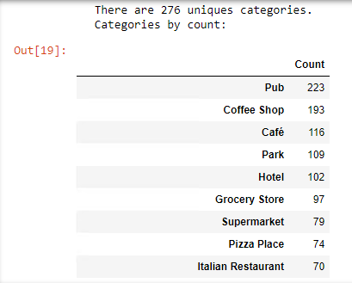
Analyses

Slide 6
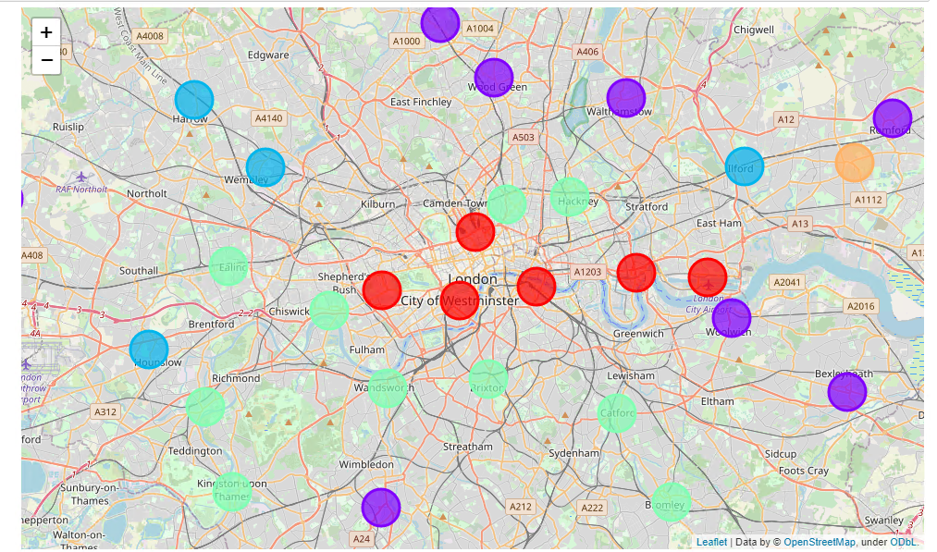
Clusters
The entire code is available on GitHub:
https://github.com/marinarot/Applied-Data_Science_Capstone/blob/master/Final%20Project/Capstone%20Project%20The%20Battle%20of%20Neighborhoods%20-%20London.ipynb

Slide 7
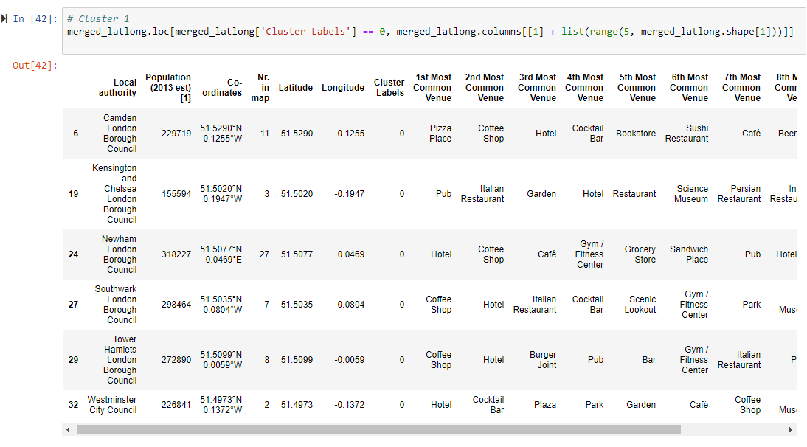
Cluster #1

Slide 8
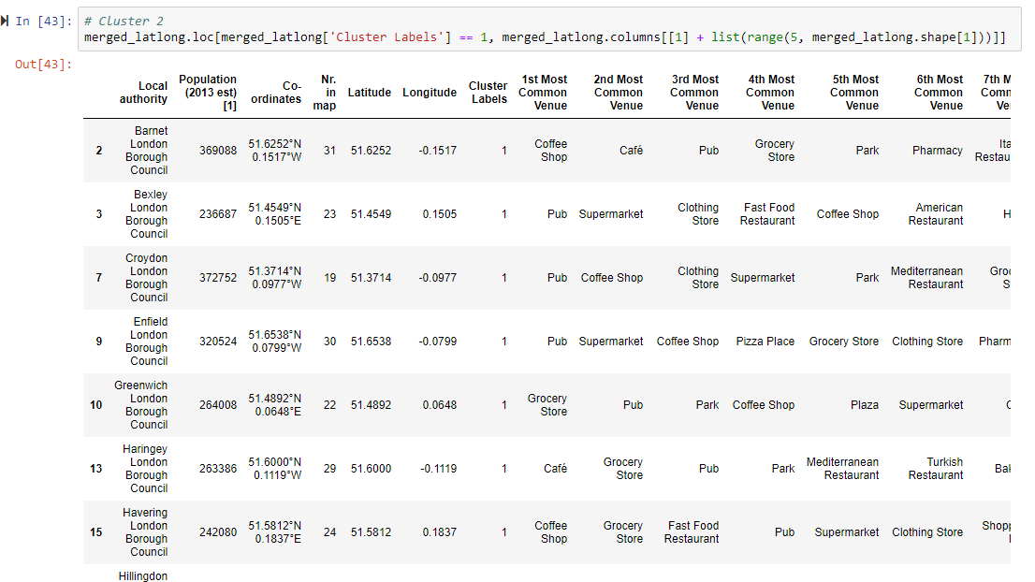
Cluster #2

Slide 9
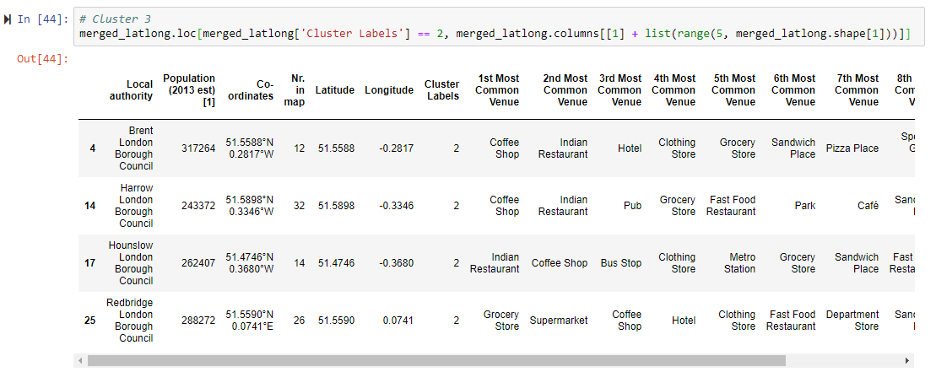
Cluster #3

Slide 10
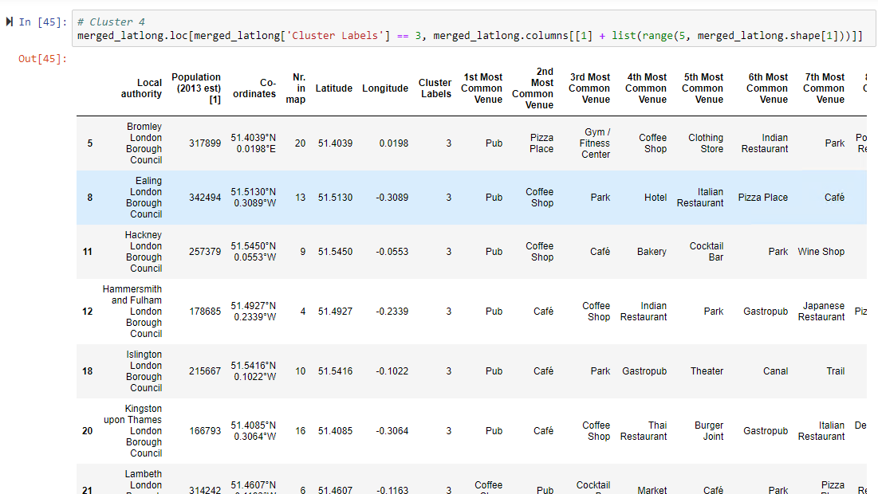
Cluster #4

Slide 11
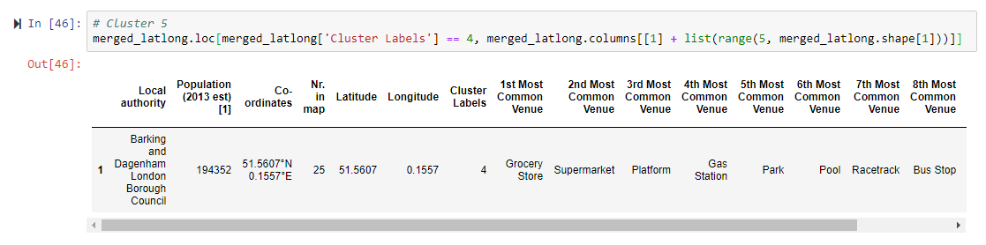
Cluster #5

Slide 12
Results
Results The following are the highlights of the 5 clusters above:
Pubs, Cafe, Coffee Shops are popular in the South East London.
As for restaurants, for example, the Indian Restaurants are very popular in Brent and Harrow areas.
Although, the Clusters have variations, a very visible presence is the predominance of pubs. (That we also could see on data analysis section)

